Slide 1
The End of ...?
COMP 4230
David J Stucki
Fall 2024

Slide 2
Machine Learning & Big Data
“Machine learning, viewed conceptually and mathematically, is intrinsically a simulation. ... The task is not to glean the actual hidden pattern directly—which would require understanding more than the data—but rather to simulate the hidden pattern by analyzing its 'footprints' in the data.” —Larson, p. 138 (Machine Learning As Simulation) —
Interview with Erik Larsen about The Myth of Artificial Intelligence
https://www.youtube.com/watch?v=rJmBGkM5SbM
Discussion

Slide 3
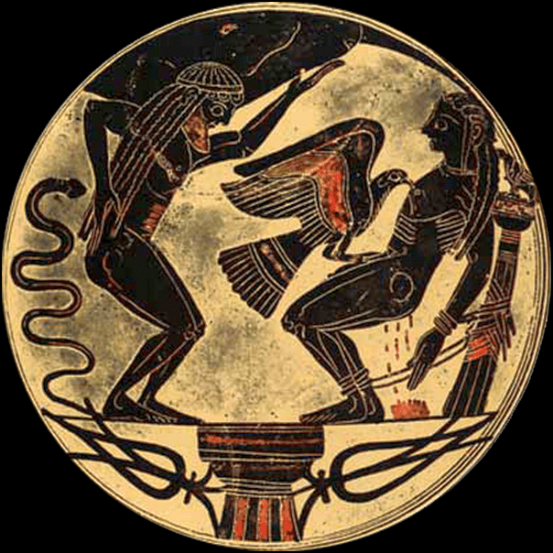
Prometheus
“[scientists] really believe in scientific genius. They really are all possessed by Prometheus, by what innovators can dream and achieve.” —Larson, p. 239 (The Promethean Myth) —
He goes on to claim that the persistent over-reach of AI predictions has caused this tendency to erode. That science has a dwindling view of human potential.
What views of AI does Hollywood promote?

Slide 4
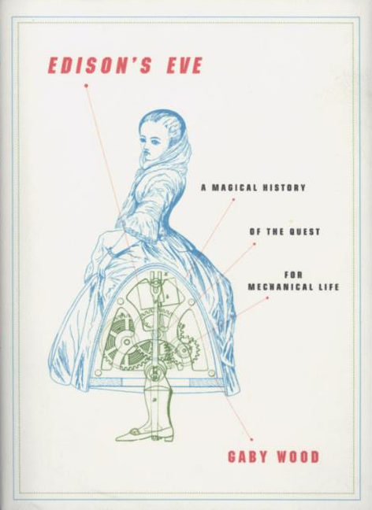
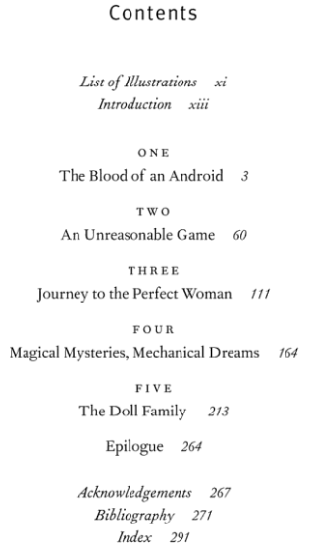
Humanizing Machines & Mechanizing Humans
“Science, once a triumph of human intelligence, now seems headed into a morass of rhetoric about the power of big data and new computational methods, where scientists’ role is now as a technician...” —Larson, p. 246 (Humans Need Not Apply) —
Discuss the Giant Brain Project. Where did it go wrong?
In what ways are machines becoming 'human'? In what ways are people becoming 'machines'?

Slide 5
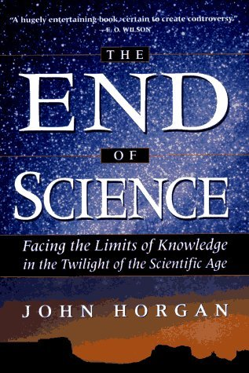
The End of Science?
“If we're not out of ideas, then we must do the hard and deliberate work of reinvesting in a culture of invention and human flourishing. For we will need our own general intelligence to find paths to the future...” —Larson, p. 281 (In Conclusion) —
Discuss the the concerns of Norbert Weiner. What are the two possible paths forward?
Is artificial intelligence an ethical pursuit?

